Slide 1
Introduction to AI
CT017-3-1 Ver 1.0
Natural Language Processing

Slide 2
Topic & Structure of the Lesson
Why NLP is needed?
NLP used for / NLP mean
Why NLP difficult
4 stages of NLP
Development of NLP
Application of NLP
Hardware and Software issues

Slide 3
Natural Language Processing
Voice / Speech Recognition
Text recognition

Slide 4
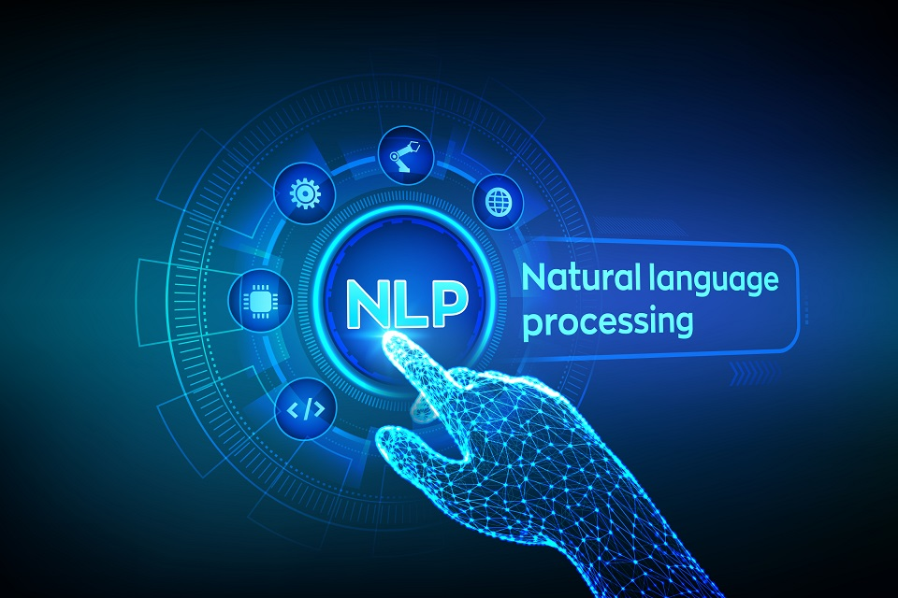
Why we need NLP?
The Basics of Natural Language Processing
https://www.youtube.com/watch?v=d4gGtcobq8M

Slide 5
NLP mean?
is a branch of artificial intelligence that deals with the interaction between computers and humans using the natural language.
The ultimate objective of NLP is to read, decipher, understand, and make sense of the human languages in a manner that is valuable.
Most NLP techniques rely on machine learning to derive meaning from human languages.

Slide 6
Continues
In fact, a typical interaction between humans and machines using Natural Language Processing could go as follows:
1. A human talks to the machine
2. The machine captures the audio
3. Audio to text conversion takes place
4. Processing of the text’s data
5. Data to audio conversion takes place
6. The machine responds to the human by playing the audio file

Slide 7
Do you know you use Natural Language processing everyday?
1.Autocomplete helps you to suggest rest of the word.
2.Google search’s predictive typing helps you by suggesting the next word.
3.Spell checker in your email application saves you from stupid typing errors.
4.Spam detection in your mail box separates spam mails from important ones.
Over the years there have been many advancements in Natural language processing.

Slide 8
What is NLP used for?
Language translation applications such as Google Translate
Word Processors such as Microsoft Word and Grammarly that employ NLP to check grammatical accuracy of texts.
Interactive Voice Response (IVR) applications used in call centers to respond to certain users’ requests.
Personal assistant applications such as OK Google, Siri, Cortana, and Alexa.
NLP vs. NLU: Natural Language Processing vs. Natural Language Understanding : https://www.youtube.com/watch?v=UmEscKl1f6E

Slide 9
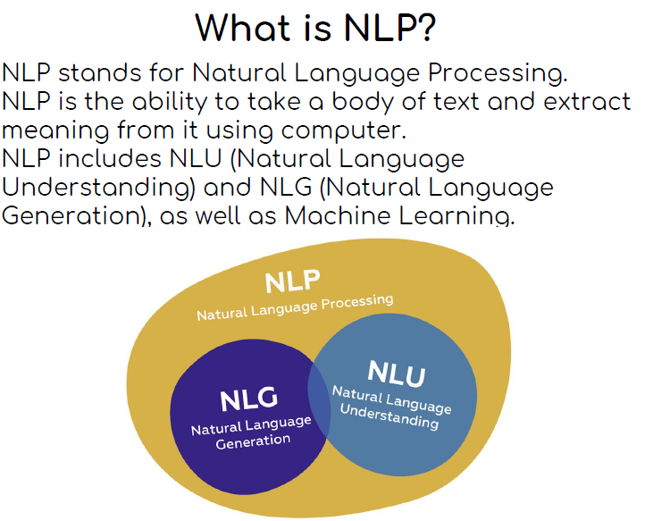

Slide 10
Difficulties in NLP
difficulties in NLP include ambiguity of meaning of words,
similar sounding words, - bare / bear
grammar inconsistencies
Ascent / sarcastic remark to pass information
and the changing nature of human language
Ex : Meet me at the bank.
What does this mean – river bank or bank?
Ex : Heavy mental
Sample
https://www.youtube.com/watch?v=MaNU_Ps-eRU
https://www.youtube.com/watch?v=6MzmIUwFzds

Slide 11
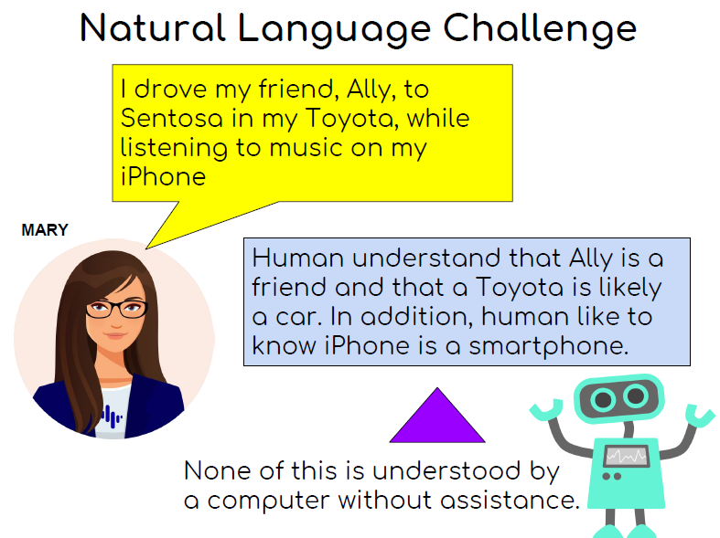

Slide 12
How does Natural Language Processing Works?
NLP entails applying algorithms to identify and extract the natural language rules such that the unstructured language data is converted into a form that computers can understand.
When the text has been provided, the computer will utilize algorithms to extract meaning associated with every sentence and collect the essential data from them.
Sometimes, the computer may fail to understand the meaning of a sentence well, leading to obscure results.
Here is the biblical sentence that required translation:
“The spirit is willing, but the flesh is weak.”
Here is the result when the sentence was translated to Russian and back to English:
“The vodka is good, but the meat is rotten.” – AI Winter video Recap

Slide 13
Speech Recognition Systems
Also known as automatic speech recognition and computer speech recognition which means understanding voice by the computer and performing any required task
Where are they used for ?

Slide 14
Where can it be used?
System control / navigation
Commercial / Industrial application - in car
Voice dialing

Slide 15
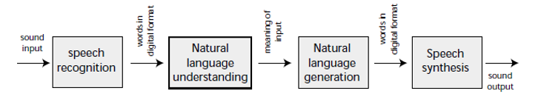
The 4 stages in NLP

Slide 16
Example
Concept Noun Verb Noun
Ex : Mary eats Lion
is this correct

Slide 17
Is NLP really AI
Ability to learn : YES
Creativity : Yes
Use of language : YES
Adapting to new situations : possible

Slide 18
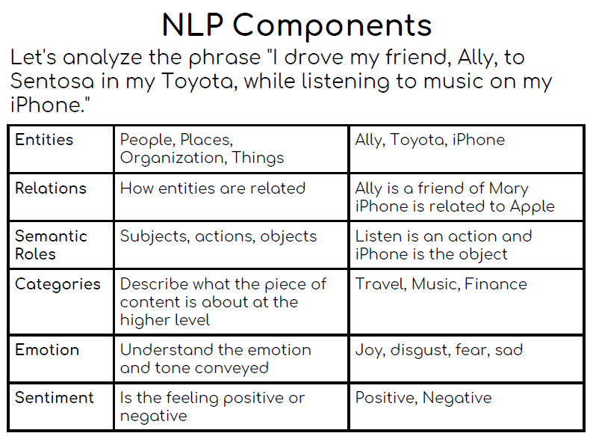

Slide 19
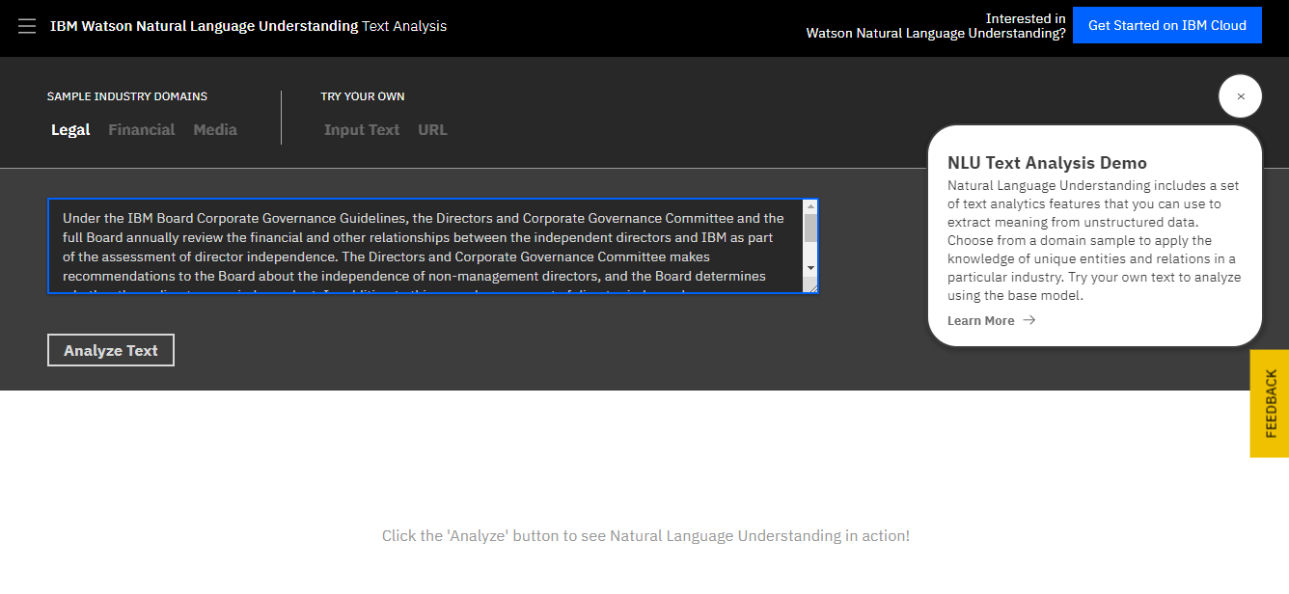
Activity 1 : NLP Components (IBM)
https://www.ibm.com/demos/live/natural-language-understanding/self-service/home

Slide 20
Activity 2 : NLU demo
Enter a phrase to Allen NLP and ask questions to a message using the transformer model
Try with below link
https://demo.allennlp.org/reading-comprehension/transformer-qa

Slide 21
Activity 3 :Tone Analysis
Analyze the tone of a text
https://tone-analyzer-demo.ng.bluemix.net/

Slide 22
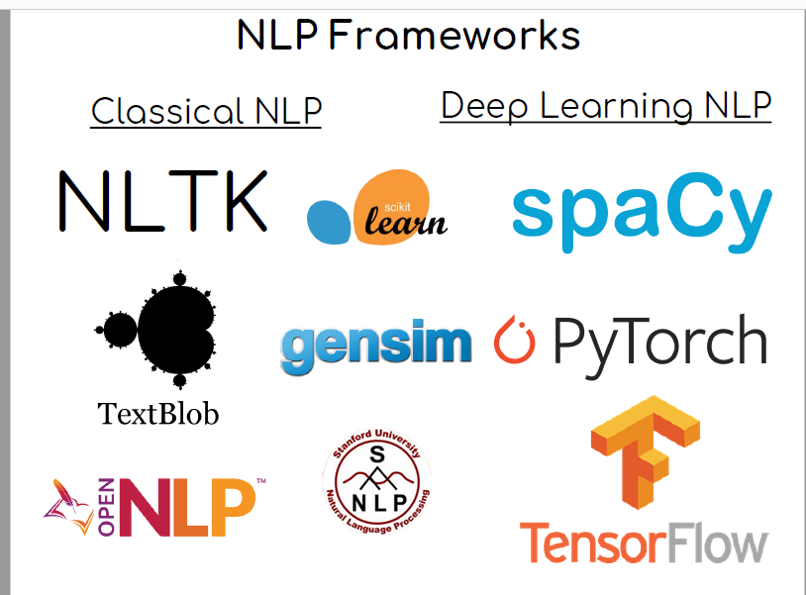

Slide 23
Case Study
The Invention And History Of Google | Silicon Valley: The Untold Story
https://www.youtube.com/watch?v=85Nyi4Xb9PY

Slide 24
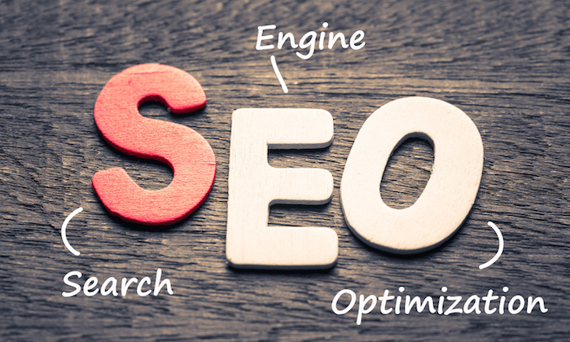
Google uses this algorithm,

Slide 25
What is Keyword
Your SEO keywords are the keywords and phrases in your web content that make it possible for people to find your site via search engine
Ex : Buy Laptop in Kuala Lumpur
Woman education in Malaysia
Developing a list of keywords in one of the first and most important steps in any

Slide 26
Keyword (cont)
You need to know how people are looking for the product, services, information – that you offer in order to make it easy fro them to find you.
Otherwise , they’ll land on one of the many other pages in the google results. Implement keyword SEO will help your site rank above your competitor

Slide 27
Keywords
APU is number 1 IT university in Malaysia. They have been opened from the year 1993 . APU started off as APIIT name and now they are a university status. From the humble beginning they were just a college in damansara office building. Then they move to become University college status – calling themselves – UCTI and now as a university APU

Slide 28
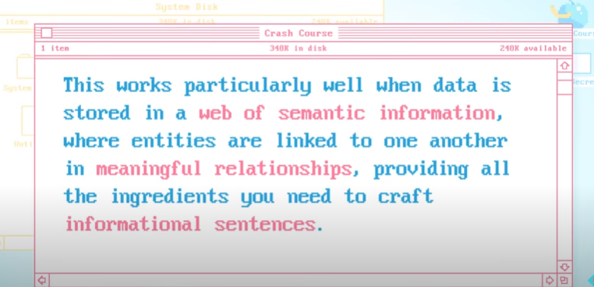
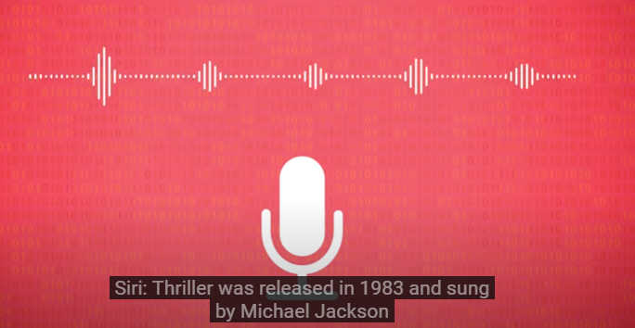
Google uses semantic network
Google uses the term knowledge graph

Slide 29
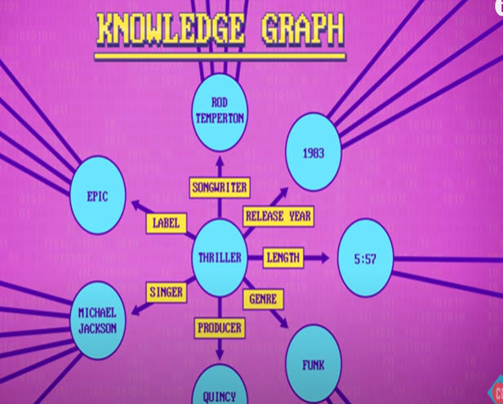
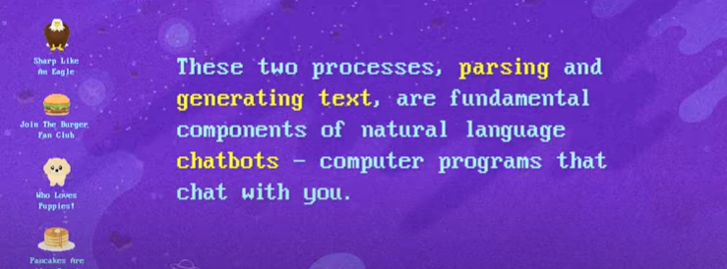
Google (continues)
At the end of 2016 , google knowledge graph contained roughly seventhy billion facts about and relationships between different entities
https://www.youtube.com/watch?v=RYc9qbY8aWs

Slide 30
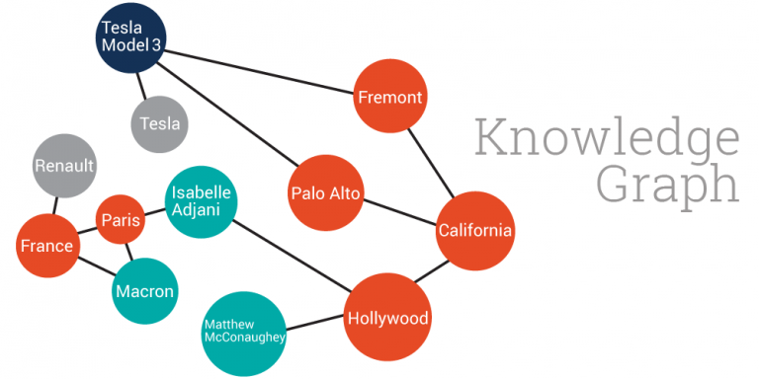
What do you understand with this

Slide 31
How to make in bigger?
Google Knowledge Graph. Google made this term popular with the announcement of its knowledge graph in 2012. However, there are very few technical details about its organization, coverage and size. There are also very limited means for using this knowledge graph outside Google’s own projects.
What do you think google did?

Slide 32

How voice recognition system helping disability
https://www.youtube.com/watch?v=apEz73_H2fU&t=1s

Slide 33
DBPedia
DBPedia. This project leverages the structure inherent in the infoboxes of Wikipedia to create an enormous dataset of 4.58 things (link https://wiki.dbpedia.org/about ) and an ontology that has encyclopedic coverage of entities such as people, places, films, books, organizations, species, diseases, etc. This dataset is at the heart of the Open Linked Data movement. It has been invaluable for organizations to bootstrap their internal knowledge graphs with millions of crowdsourced entities.

Slide 34
Goenames
Geonames. Under a creative commons, users of Geonames dataset have access to 25 million geographical entities and features.

Slide 35
Wordnet
Wordnet. One of the most well-known lexical databases for the English language, providing definitions and synonyms. Often used to enhance the performance of NLP and search applications.

Slide 36
Fact Forge
FactForge. After years of developing expertise in the news publishing industry, Ontotext produced their knowledge graph of Linked Open Data and news articles about people, organizations and locations. It incorporates the data from the KGs described above as well as specialized ontologies such as the Financial Industry Business Ontology.

Slide 37

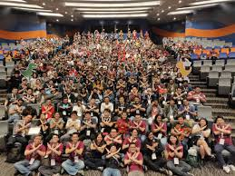

What are they doing more?
DevFests are community-led developer events hosted by Google Developer Groups around the globe. GDGs are focused on community building and learning ...

Slide 38



Slide 39
Early chatbot
Early chatbots were primary rule-based, where experts would encode hundreds of rules mapping what a user might say, to how a program should reply
Recap – which chatbot?
Today – because of memory – train huge number of sentences with machine learning and make chatbots better which is customer relationship bot – lot and lots of recorded samples

Slide 40
Future of google
What are the areas of new research
https://www.youtube.com/watch?v=LsduLIKQRPo

Slide 41
Case study 2 : Facebook
What is facebook - https://www.youtube.com/watch?v=StPGR1URK5A
Facebook chatbot started making its own language.
People got scared
https://www.youtube.com/watch?v=ONPqeHJShdQ

Slide 42
Why Facebook is Investing in Natural Language Processing
Facebook has been investing heavily in Natural Language Processing
Facebook wants to enable developers to evaluate AI-based natural-language code search system efficiently. AI research division released a library of coding questions with matching answers.
Facebook AI code-search models available to programmers. The release also included a training corpus of more than 4 million Java methods parsed from over 24,000 GitHub repositories.

Slide 43
Facebook (continue)
Besides, the effort also indicates artificial intelligence to support and optimize human labor. AI could make us better at it
Facebook form AI Language Research Consortium.
Representation learning, content understanding, dialog systems, information extraction, sentiment analysis, summarization, data collection and cleaning, and speech translation.
Facebook PyText NLP framework
https://www.youtube.com/watch?v=INnV2VeSBMc

Slide 44
Lets discuss
Opinion on facebook
https://www.youtube.com/watch?v=rkxxeDScKLQ

Slide 45
Conclusion
Natural Language Processing plays a critical role in supporting machine-human interactions.
As more research is being carried in this field, we expect to see more breakthroughs that will make machines smarter at recognizing and understanding the human language.
Have you used any NLP technique in enhancing the functionality of your application?

Slide 46
What’s your opinion
https://www.youtube.com/watch?v=f9v6givfTEA

Slide 47
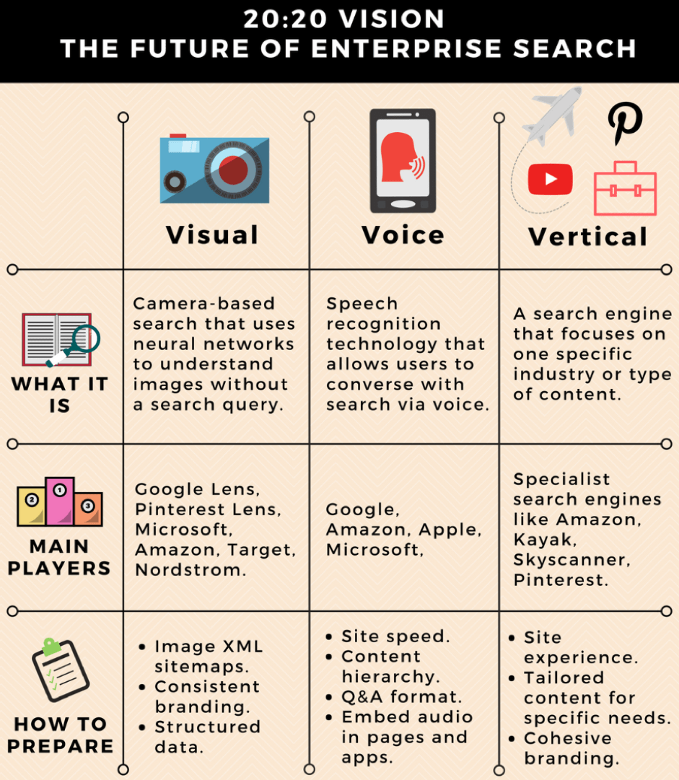
https://www.searchenginejournal.com/future-of-enterprise-search/260871/

Slide 48
Tutorial
What are the 2 main areas of NLP?
Explain the main goal of NLP
What must you do before using speech recognition and roughly how long will it take?
Why do we have to go through the process in Q3
Name 2 important factor affecting accuracy when using speech recognition
List 4 recommendations when speaking into the microphone
Explain how Speech Recognition can use used to help the disabled
List 3 military uses of speech recognition

Slide 49
9. Explain how Speech technology can be used to allow people who speak different language to communicate
10. Name one advantage of using handwriting technology rather than a conventional input method
11. List 2 tips which will improve accuracy when using handwriting recognition
Upload answer on students tutorial folder – name your doc – with your name
Upload your answer in the teams – student folder with your name as the file name

Slide 50
Question and Answer Session
Q & A

